Slide 1
Extinction Risk Estimation
Lecture 9

Slide 2
Background
Extinction risk can be estimated analytically for some models, but generally we base extinction risk estimation on Monte Carlo simulations.
We will consider a variety of ways of analyzing a given problem.

Slide 3
Basic Specifications
A model of the population dynamics including:
  how the population dynamics are updated from one time-step to the next, and
  how the population is impacted by human and environmental factors.
The status of the population at the start of the simulation.
A definition of “quasi-extinction”.
The values for the parameters that determine the probabilities of “catastrophes”.

Slide 4
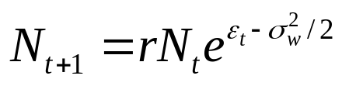
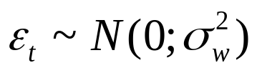

An Initial Model-I
(Basic specifications)
The population model:
The initial size is 500 and quasi-extinction occurs when the
population drops below 10.
The probability of extinction is based on 1000 simulations of
a 100-year period.

Slide 5
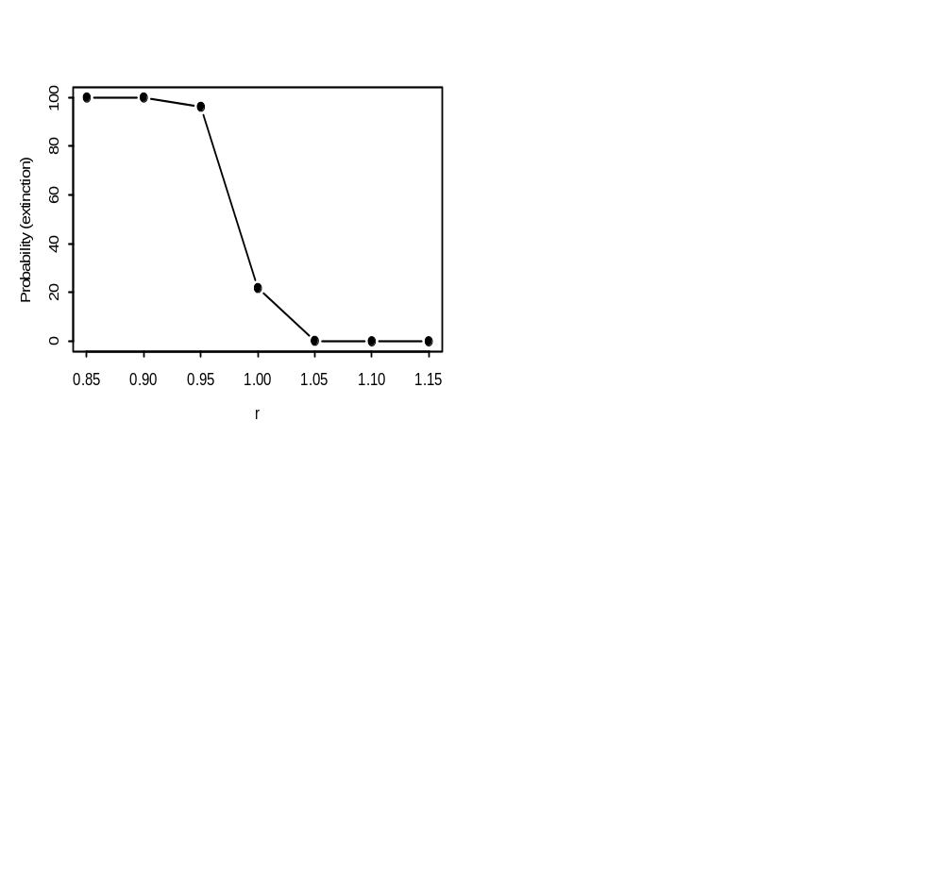
An Initial Model-II
(Results)
Probability of extinction versus intrinsic growth rate.

Slide 6
An Initial Model-III
(R Code)
DoProject <- function(r,Start_val=500,Thresh=10,Nyears=100,Nsim=1000,SigP=0.2)
{
WentExtinct <- 0
for (Isim in 1:Nsim)
{
Nvalue <- Start_val
Extinct <- F
for (Iyr in 1:Nyears)
{
Nvalue <- r*Nvalue*exp(rnorm(1,0,SigP) - SigP^2/2)
if (Nvalue < Thresh) Extinct <- T
}
if (Extinct==T) WentExtinct <- WentExtinct + 1
}
return(WentExtinct/Nsim*100)
}

Slide 7
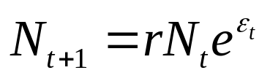
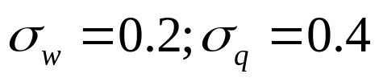
Allowing for Catastrophes
(Specifications)
The population model:
The initial size is 500 and quasi-extinction occurs when the
population drops below 10. We select a
catastrophic event with probability 0.1.
The probability of extinction is based on 1000 simulations of
a 100-year period.

Slide 8
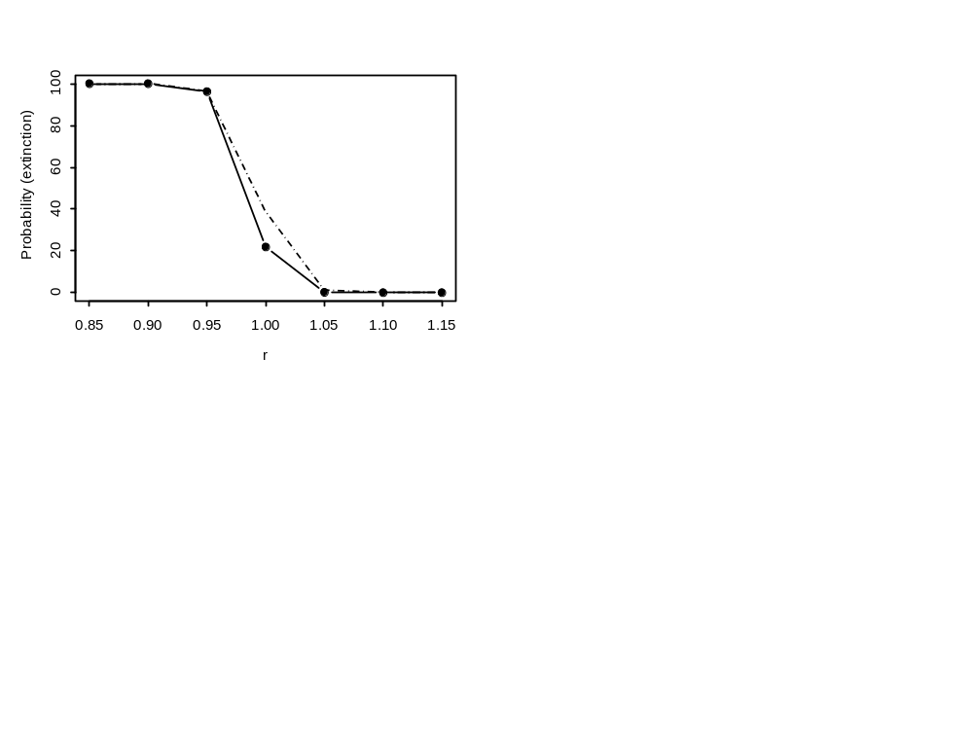
Allowing for Catastrophes
(Results)
Solid – no catastrophes; dashed – with catastrophes

Slide 9
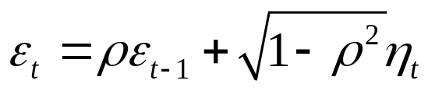
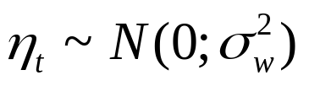

Allowing for Temporal Correlation -I
(Basic specifications)
The population model:
The initial size is 500 and quasi-extinction occurs when the
population drops below 10.
The probability of extinction is based on 1000 simulations of
a 100-year period.

Slide 10

Allowing for Temporal Correlation -II
(Results)
Solid – no temporal correlation; dashed – with temporal
correlation

Slide 11
Allowing for Temporal Correlation
Modify the pseudo code to allow for temporal correlation.

Slide 12
Spatial Structure
Consider the case where the species is found in “n” regions. How would you model the cases:
  Each region is impacted by separate environmental factors.
  Each region is impacted by the same environmental factor.
  There is spatial correlation in the how environmental factors impact the regions.

Slide 13
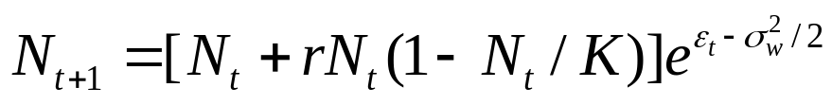
Allowing for Density-Dependence / Depensation-I
The population model with density dependence:
Now add depensation:
N₅₀ is the population size at which r is half its reference value.

Slide 14
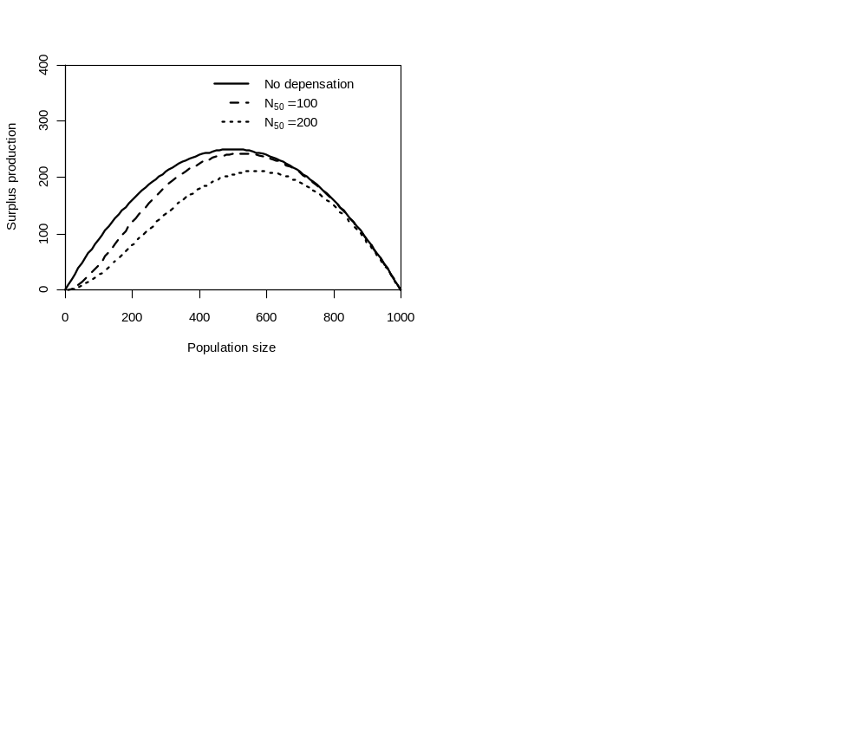
Allowing for Density-Dependence / Depensation-II

Slide 15

Allowing for Density-Dependence / Depensation-III
Why does this
Happen?
Logistic model vs. N₅₀=200

Slide 16
Extensions to the Logistic-Depensation model
Habitat degradation | Changes in K
Environmental change | Changes in r and K
Exploitation | Add in removals
Catastrophic events | Add in “extreme” process errors
Demographic uncertainty | Normal process error

Slide 17
Models with stage-structure
(The Iberian lynx example)
The Iberian lynx, Lynx pardinus, is a vulnerable species found in Portugal and Spain.
The question we need to address is the impact of the number of territories within each habitat patch on extinction risk.

Slide 18

The Iberian lynx example
(Basic assumptions)
We will assume:
  The population is distributed across a number of patches, but there is no movement among patches.
  The population is subject to demographic stochasticity in survival.
  There are (occasional) droughts which could reduce first-year survival.
  Density-dependence is imposed by setting a cap on the numbers of territories per habitat patch (breeders will only breed if they find a territory).
  The population consists of four classes: cubs, subadults, adults without territories, and breeders.

Slide 19
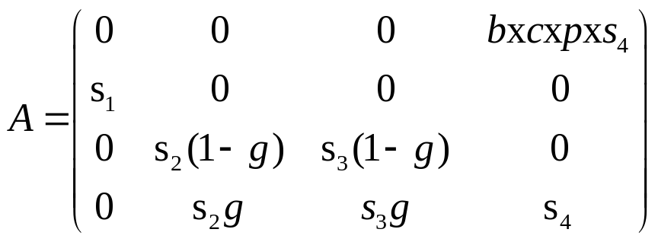
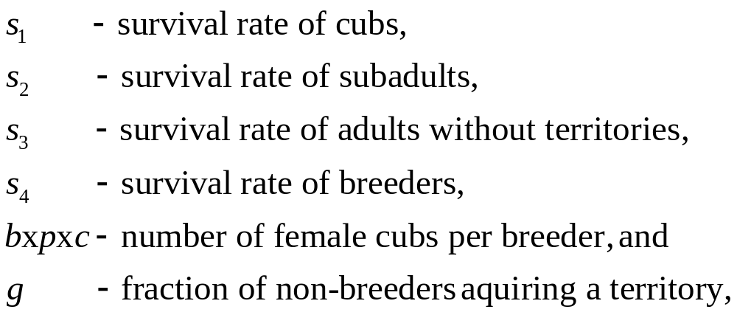
The Iberian lynx example
(The basic population model)

Slide 20
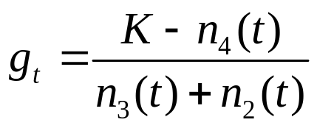
The Iberian lynx example
(Modeling territories)
We will assume that there are K territories and that at time t, n₄(t) territories are occupied.
Assuming the sub-adults and adults without territories are equally likely to occupy an empty territory, g is given by:

Slide 21
The Iberian lynx example
(Modeling droughts)
We will assume that there is a probability q (=0.1) of a drought.
In normal years, the survival rate of cubs is 0.5, but it is only 0.2 if there is a drought.

Slide 22
The Iberian lynx example
(Parameter values)
s₁ | See previous slide
s₂ | 0.7
s₃ | 0.7
s₄ | 0.86
bxcxp | 0.87=0.5*0.6*2.9

Slide 23
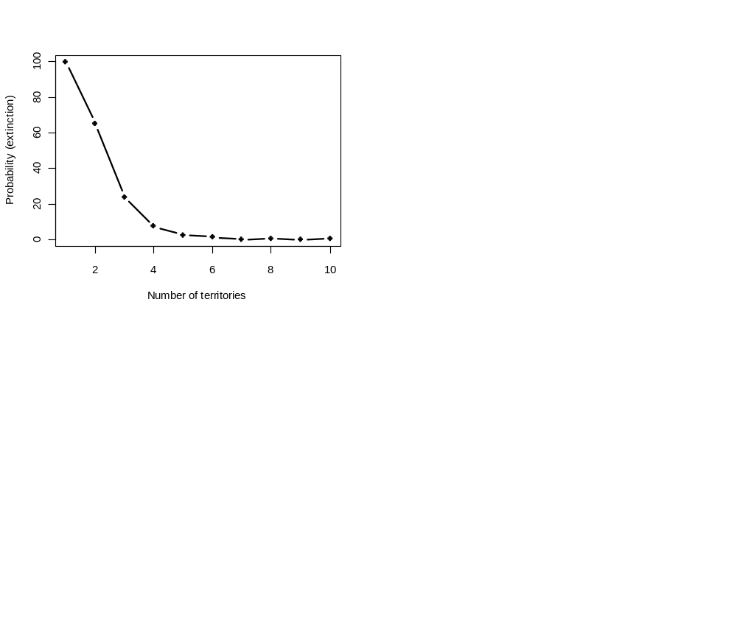
The Iberian lynx example
(Results)
Initial stage structure = c(4,2,0,5); 50-year projection;
1000 replicates for each scenario.

Slide 24
The Iberian lynx example
(Next steps-I)
Model extensions:
  Determine how sensitive the results are the frequency of droughts, first year survival, etc. Which parameter would you consider most important to estimate.
  Extend the model to include multiple patches linked by migration corridors.

Slide 25
The Iberian lynx example
(Next steps-II)
Decision analysis issues:
  If the population consists of multiple patches (each with a different number of territories – say 1-5). How would you manage this species? Let us say you can’t add new patches.
  Develop a decision analysis to compare different strategies (e.g. adding more habitat to patches to increase the number of territories, reducing the impact of droughts, increasing subadult survival).

